Slide 1
Introduction to Cloud Basic
Lesson 01: Cloud Basic Concepts
Notes:
Add instructor notes here.

Slide 2
Lesson Objectives
In this lesson, you will learn:
What is and Why Cloud?
Why Cloud Computing
Key characteristics of Cloud
Cloud Computing Architecture
Cloud Deployment and Service Model Selection criteria
Cloud APIs
Cloud benefits and Challenges
Different Cloud implementer
Latest trend
Notes:
What is and Why Cloud
Why Cloud Computing
Key characteristics of Cloud
Cloud Computing Architecture
Cloud Model Selection criteria
Different types of Cloud(Private , Public , Hybrid)
Cloud APIs
Cloud benefits
Different Cloud implementer
Latest trend
This lesson is to give an Introduction on Java Server Pages

Slide 3
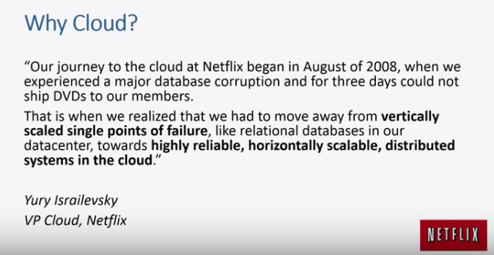
1.1: What and why Cloud Why Cloud

Slide 4

1.1: What and why Cloud What is Cloud?
Notes:
Cloud has a different meaning depends on the role of each person
Explain role of JSP in web applications and “big picture”

Slide 5
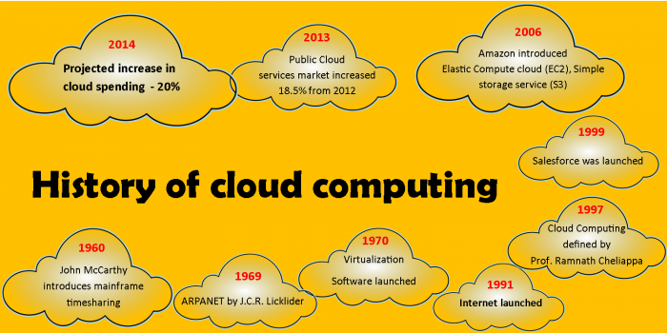
1.1: What and why Cloud History ?
Concept evolved in 1950(IBM) was called RJE( Remote Job entry process )
In 2006 , Amazon provides the first public cloud AWS( Amazon Web Service)
Notes:
Cloud for Programmers Views :--
It is automated - I don’t need to depend upon System engineer anymore.
It is fast - It is faster then any thing
It is reliable - It is high availability in itself without changing my code.
It is less cost then any other solution . Buying Server only , if you have more money.
(If one has Money , pay for Cloud and Use it . )
Explain role of JSP in web applications and “big picture”

Slide 6
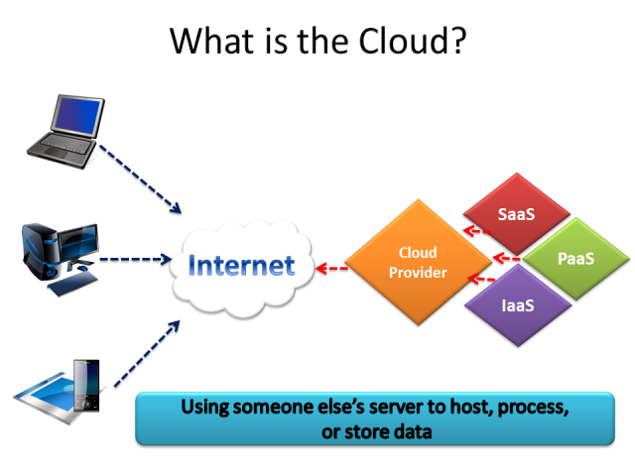
1.1: What and why Cloud What is Cloud ?
The term Cloud refers to a Network or Internet.
Cloud is something which present in remote location.
Cloud can provide services over network.
Private network
Public network
Application all runs in Cloud
email ,
web conferencing
CRM
Notes:
Explain role of JSP in web applications and “big picture”

Slide 7
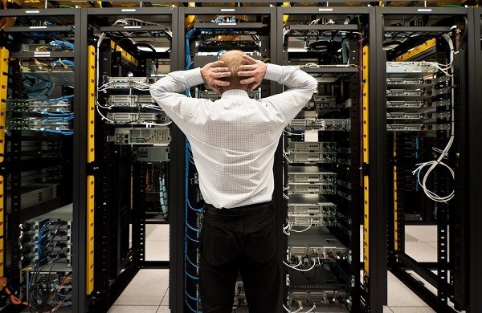
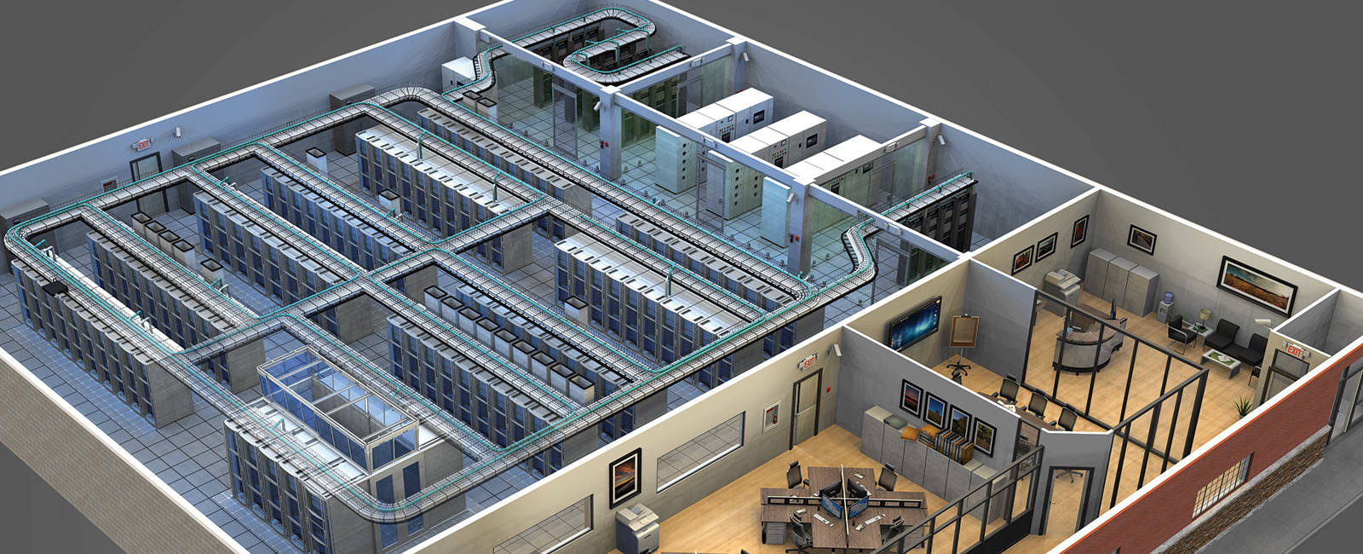
1.1: What and why Cloud Traditional Data Center

Slide 8
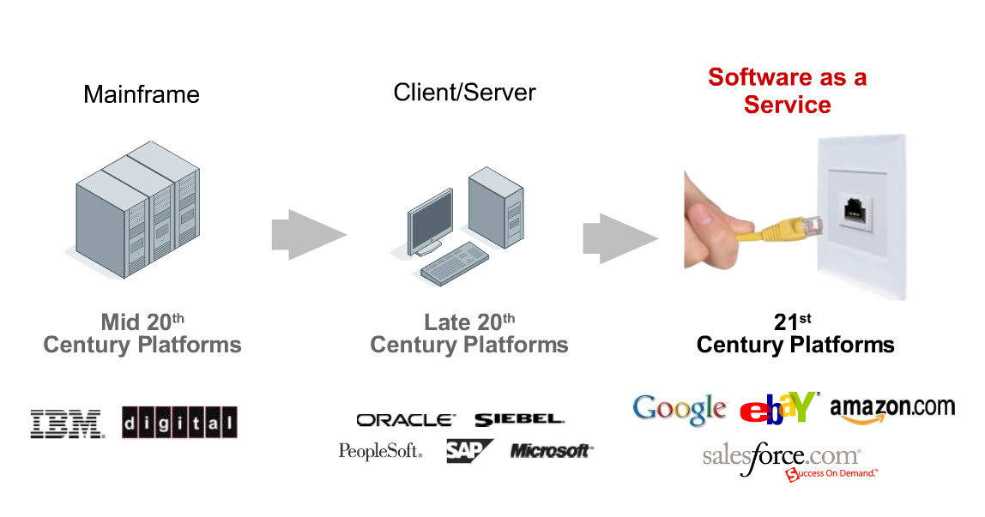
1.1: What and why Cloud IT Platform Evolution over the last 40 years
Now moving towards Plug-and-Play software and IT services
This is where Cloud is an enabler

Slide 9
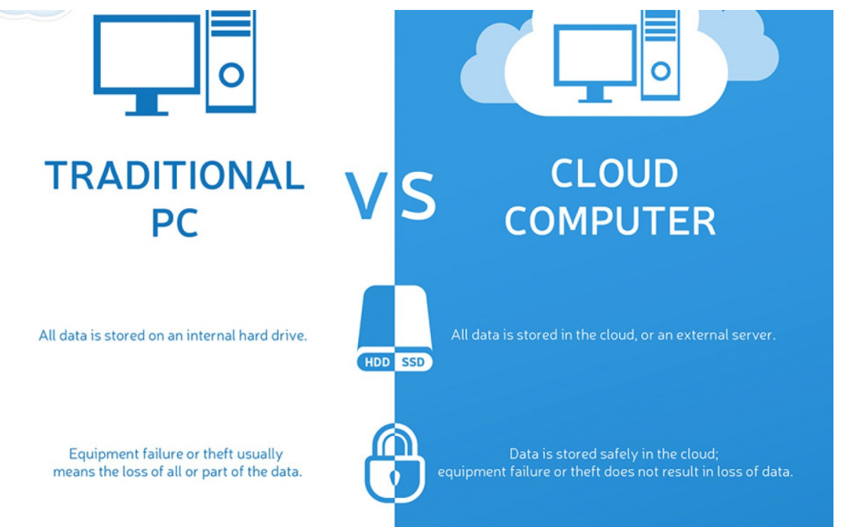
2.1 Cloud technology Enterprise Servers vs Cloud Servers

Slide 10
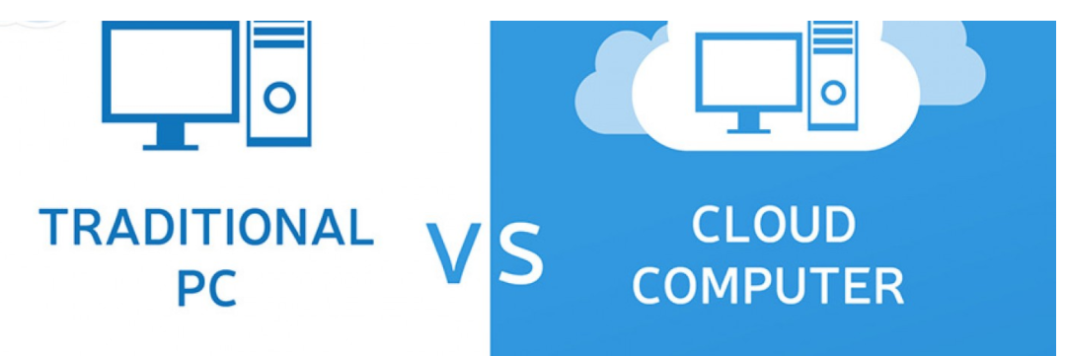
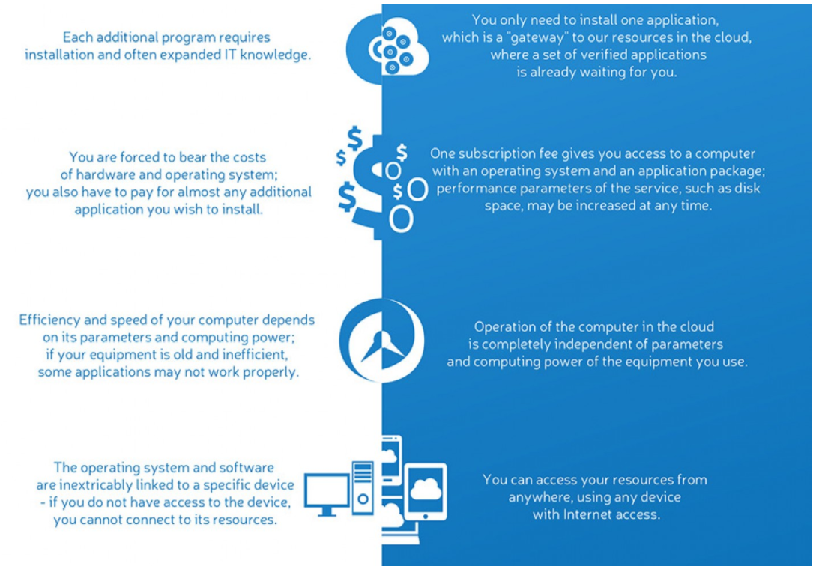
2.1 Cloud technology Enterprise Servers vs Cloud Servers

Slide 11
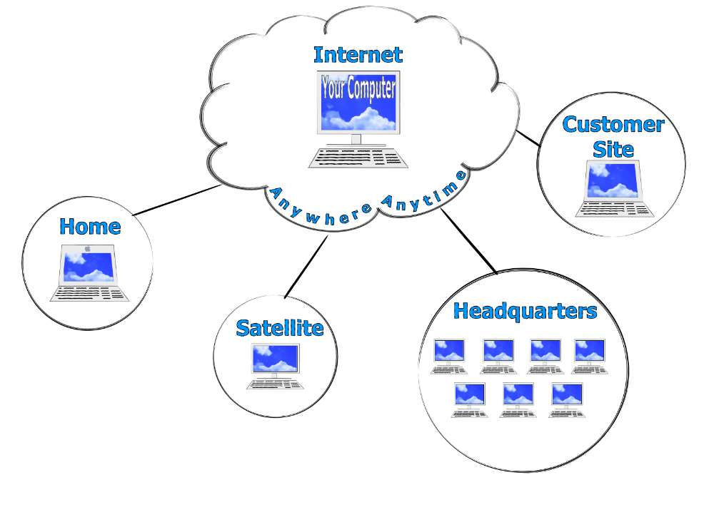
1.1: What and why Cloud Cloud in Marketer’s Eyes ?
It is in the Internet.
It is easy to use .
It is new .
It is better than Non cloud .
(If one has Money , pay for Cloud and Use it . )
Notes:
Clod Mareter’s Eyes View :-
It is in the Internet.
It is easy to use .
It is new .
It is better then Non cloud .
(If one has Money , pay for Cloud and Use it . )
Explain role of JSP in web applications and “big picture”

Slide 12
1.1: What and why Cloud Cloud for Programmers
It is automated.
It is fast .
It is reliable .
It is less cost than any other solution .
Notes:
Cloud for Programmers Views :--
It is automated - I don’t need to depend upon System engineer anymore.
It is fast - It is faster then any thing
It is reliable - It is high availability in itself without changing my code.
It is less cost then any other solution . Buying Server only , if you have more money.
(If one has Money , pay for Cloud and Use it . )
Explain role of JSP in web applications and “big picture”

Slide 13
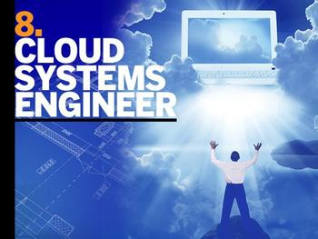
1.1: What and why Cloud Cloud for System engineers
It is automated.
It is not fast .
It is reliable .
It is not flexible.
Notes:
Cloud for System engineers :--
It is automated - I don’t need to do hard work anymore.
It is not fast - Speed comes with Cost
It is reliable - I am free , I can say , I can sleep along night
It is not flexible – One can’t configure or tune it.
Explain role of JSP in web applications and “big picture”

Slide 14
1.1: What and why Cloud Cloud for Manager
Cloud is Cheap and few said Cloud is costly
It is Flexible .
It is reliable / unreliable .
Business can be competitive with Cloud
Notes:
Cloud for Manager :--
Cloud is Cheap and few said Cloud is costly - Manager doesn’t have to hire System engineer
It is Flexible .- one can buy anything in 1 minute
It is reliable / unreliable – What will be happened if Cloud company bankrupt
Business can be competitive with Cloud
This lesson is to give an Introduction on Java Server Pages

Slide 15
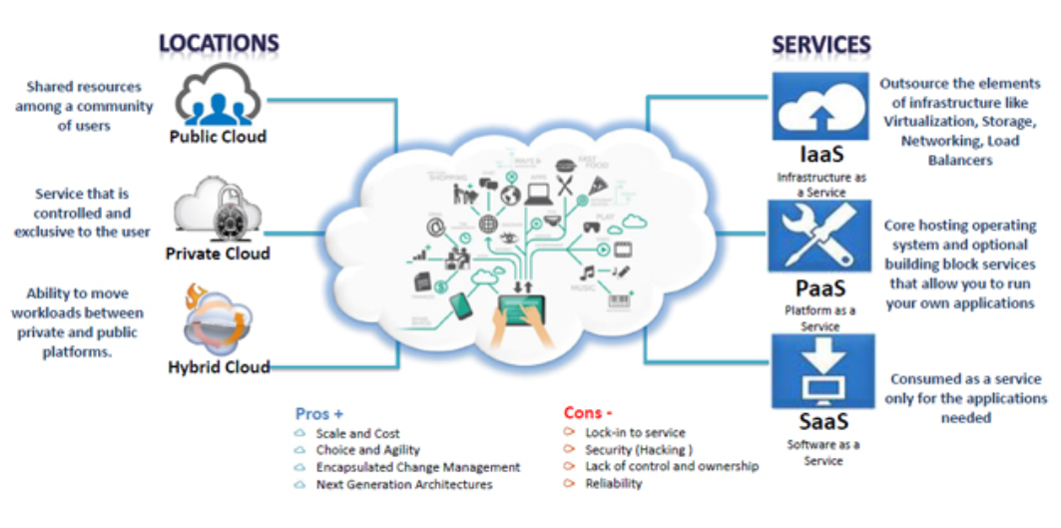
2.1: Cloud technology What is Cloud Computing?
Notes:
In simple terms it means the customer is charged based on the amount of computing service they use
Distributed computing on Internet or delivery of Computing service over the Internet.
Instead of running an e-mail program on your computer,
you log in to a Web e-mail account remotely.
The software and storage for your account doesn't exist on your computer -- it's on the service's computer Cloud.

Slide 16
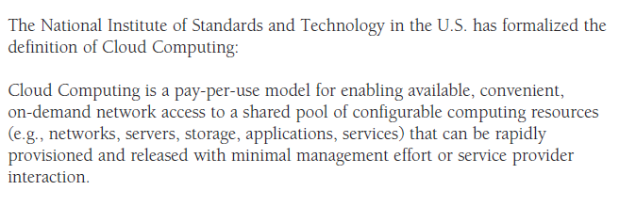
1.2: Cloud computing What is Cloud Computing?
In simple terms it means the customer is charged based on the amount of computing service they use
Notes:
In simple terms it means the customer is charged based on the amount of computing service they use

Slide 17
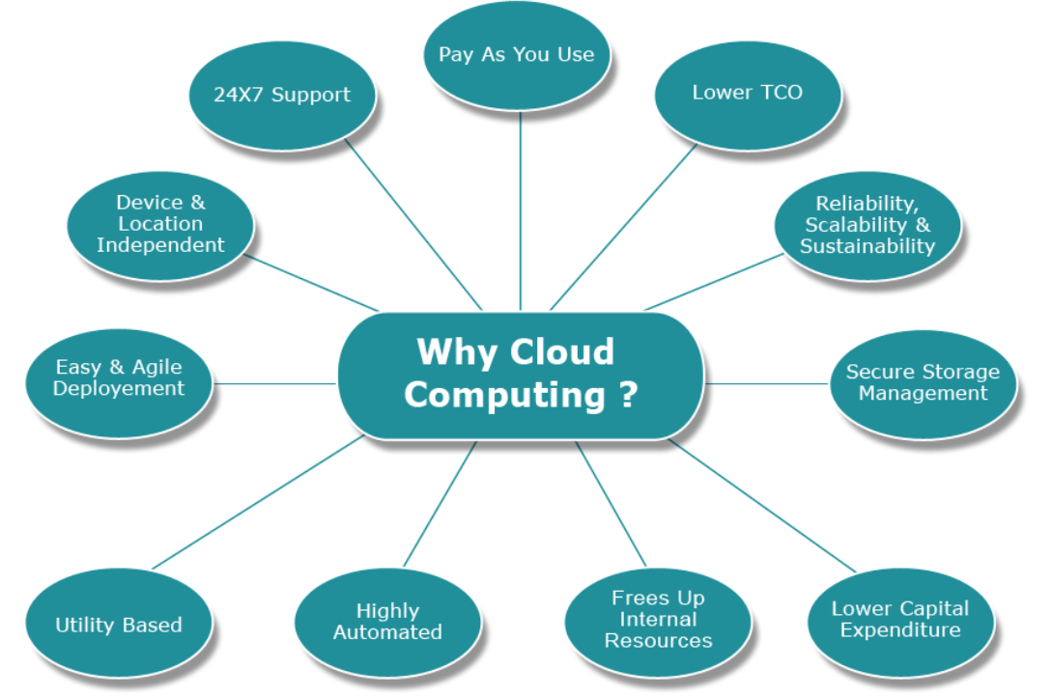
2.1: Cloud technology Why Cloud Computing?
Cloud computing is a style of Computing in which scalable and elastic IT-enabled capabilities are delivered as a Service using Internet technology .
Notes:
Cloud computing is a style of Computing in which scalable and elastic IT-enabled capabilities are delivered as a Service using Internet technology
Explain role of JSP in web applications and “big picture”

Slide 18
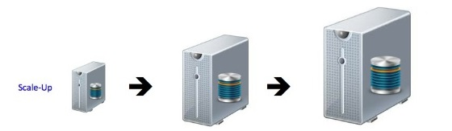
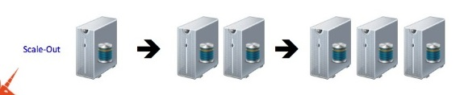
1.1: What and why Cloud Scale Up vs Scale Out

Slide 19
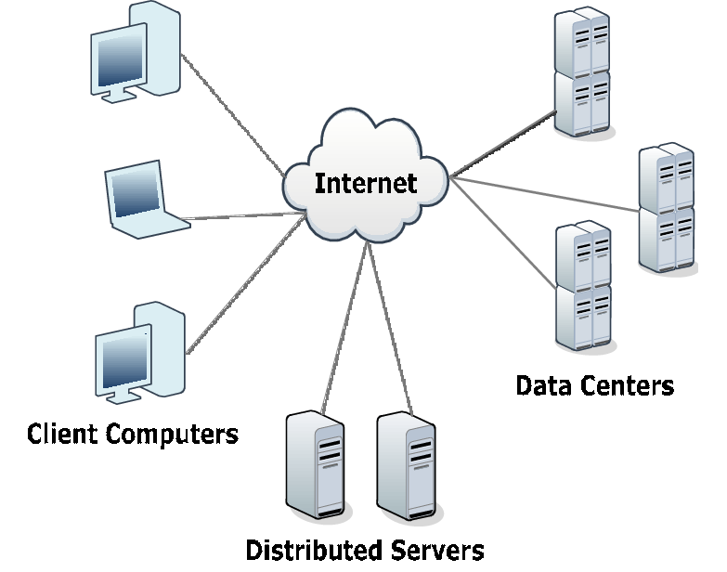
1.2: Cloud computing Cloud components
Cloud Components has three components
Notes:
Client Computers : -- Client are the devices used to interact with cloud . i,.e. Mobile , Desktop machine
Distributed Servers :--- Servers are available in different geographically places but act as they are present in very close by.
Datacenters : --- It is a collection of Servers , where the application is placed and is accessed via Internet
Explain role of JSP in web applications and “big picture”

Slide 20
1.3: Key Characteristics Key Characteristics of Cloud & some definitions
Cost | Agility | Device Location Independence
Multi-Tenancy | Reliability | Scalability
Security | Elasticity | Virtualization
Notes:
Agility – Speed of provisioning and delivering environments and projects
Elasticity - The ability to add or reduce infrastructure elements within the ecosystem as per actual demand. No capacity planning
.

Slide 21
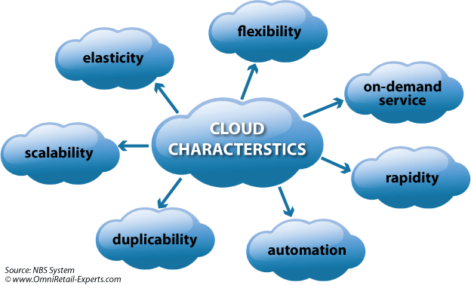
1.3: Key Characteristics Key Characteristics of Cloud & some definitions
Notes:
Scalability – The ability to add or reduce infrastructure elements within the ecosystem as per actual demand. No capacity planning
.
Virtualization - Virtualization technology allows cloud providers to convert one server into many virtual machines, thereby eliminating client/server computing with single-purpose systems, maximizing hardware capacity
Multi-Tenancy – Resources are shared across multiple clients and not dedicated infrastructure. This reduces costs and makes use of best practices in data isolation and security.

Slide 22
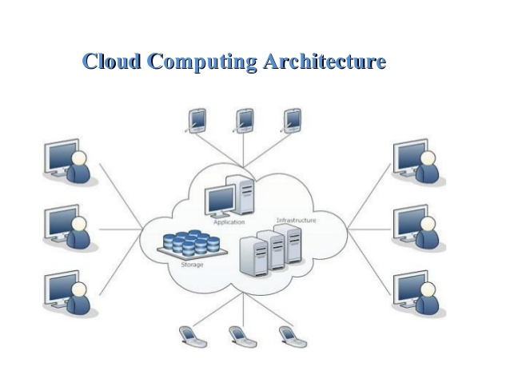
1.4: Cloud computing Architecture Cloud Computing Architecture
Notes:
Explain role of JSP in web applications and “big picture”

Slide 23
1.5: Cloud Deployment Model Selection criteria Basic Concepts of cloud computing
There are certain services and models working behind the scene making the cloud computing feasible and accessible to end users .
The Working models of Cloud computing:
Deployment Models
Service Models

Slide 24
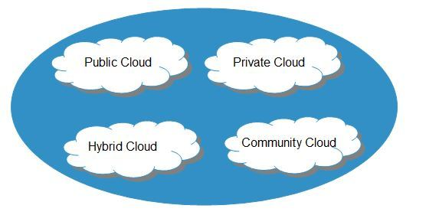
1.5: Cloud Deployment Model Selection criteria Deployment Models
.
Notes:
PUBLIC CLOUD : ---
The Public Cloud allows systems and services to be easily accessible to the general public.
Public cloud may be less secure because of its openness, e.g., e-mail.
PRIVATE CLOUD : --
The Private Cloud allows systems and services to be accessible within an organization.
It offers increased security because of its private nature.
COMMUNITY CLOUD :---
The Community Cloud allows systems and services to be accessible by group of organizations.
HYBRID CLOUD :---
The Hybrid Cloud is mixture of public and private cloud. However, the critical activities are performed using private cloud while the non-critical activities are performed using public cloud.

Slide 25
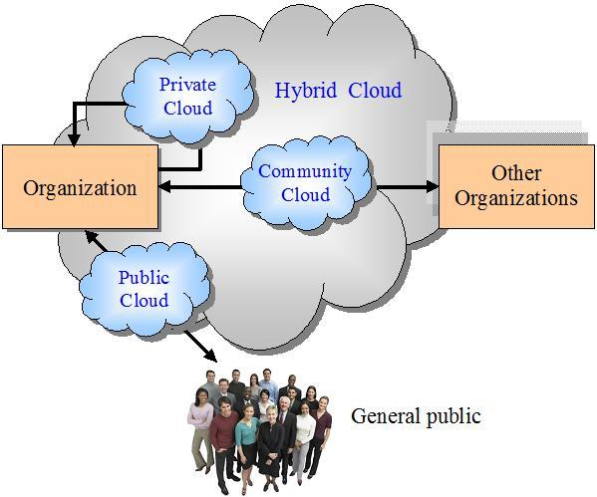
1.5: Cloud Deployment Model Selection criteria Deployment Models
.

Slide 26
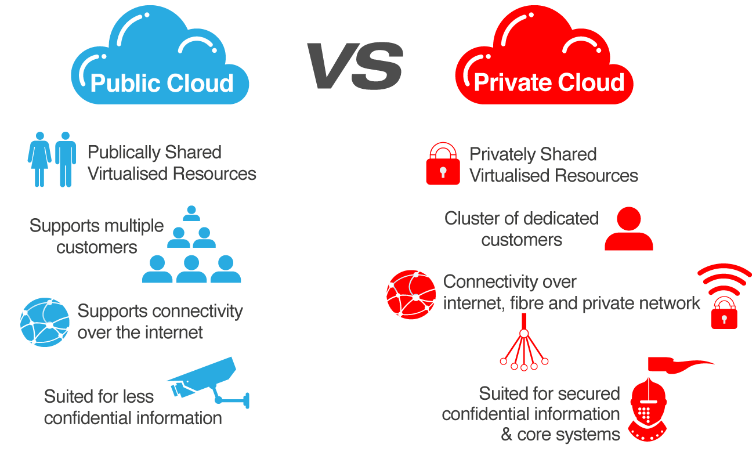
1.5: Cloud Deployment Model Selection criteria Private & Public Clouds Comparison
Low Cost
Higher Cost

Slide 27
1.5: Cloud Deployment Model Selection criteria What is Hybrid Cloud?
Hybrid cloud
is a cloud computing environment which uses a mix of
on-premises,
private cloud and
third-party public cloud
services with orchestration between these platforms.

Slide 28
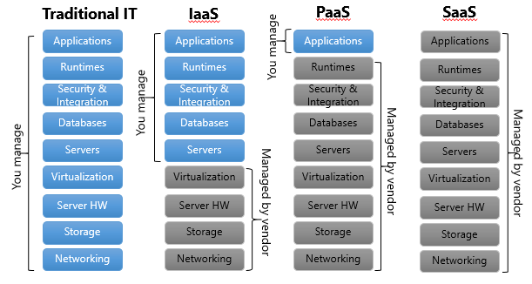
1.5: Cloud Deployment Model Selection criteria Service Models
These are the reference models on which the cloud computing is based.

Slide 29
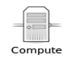
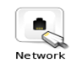
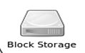
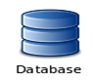
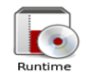
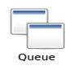
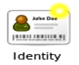
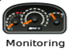
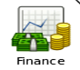
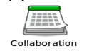
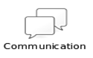

1.5: Cloud Deployment Model Selection criteria IaaS, PaaS and SaaS
IaaS – Basic storage and computing power offered as a service over the internet
PaaS- provides one aspect of software layer and provides it for consumers to build higher-level services
SaaS – Complete application is offered as an on-demand service
A single instance of the app runs on the Cloud and services multiple users or client organizations
Notes:
Infrastructure as a Service (IaaS) :-----
Infrastructure as a Service (IaaS) IaaS is the delivery of technology infrastructure as an on demand scalable service.
IaaS provides access to fundamental resources such as physical machines, virtual machines, virtual storage, etc.
Usually billed based on usage •
Usually multi tenant virtualized environment •
Can be coupled with Managed Services for OS and application support
Platform as a Service :---
It provides the runtime environment for applications, development & deployment tools, etc.
PaaS provides all of the facilities required to support the complete life cycle of building and delivering web applications and services entirely from the Internet.
Typically applications must be developed with a particular platform in mind •
Multi tenant environments •
Highly scalable multi tier architecture
Software as a Service :---
SaaS model allows to use software applications as a service to end users.
SaaS is a software delivery methodology that provides licensed multi-tenant access to software and its functions remotely as a Web-based service. •
Usually billed based on usage •
Usually multi tenant environment •
Highly scalable architecture

Slide 30
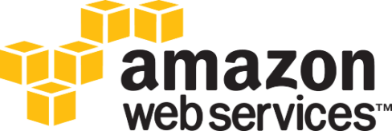
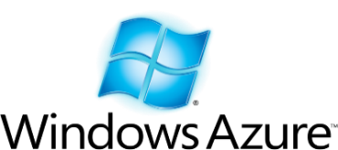
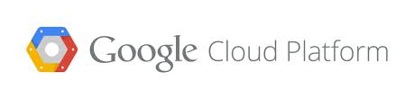


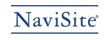






$12 Billion market in 2017
Exemplary Performers
IaaS
PaaS
Viable Performers
SaaS
Adequate Performers

Slide 31
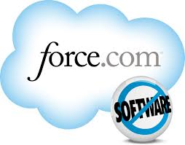









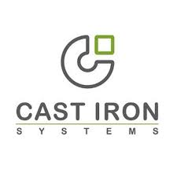



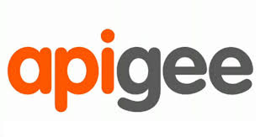
PaaS market of $14 Billion in 2017
Exemplary Performers
IaaS
PaaS
Viable Performers
SaaS
Adequate Performers
PaaS vendors release build packs for Java / Ruby / angular.js which make SDLC faster and easier

Slide 32

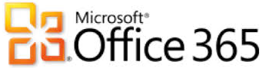











Gartner predicts SaaS market to reach $ 70 Billion in 2018
Exemplary Performers
IaaS
PaaS
Viable Performers
SaaS
Adequate Performers

Slide 33
1.5: Cloud Deployment Model Selection criteria
Cloud Model Selection Criteria
Business Process as a Service
(BPaaS)
E.g. Finance BPO, Payroll
Their people, process, application, platform + Infrastructure
Software-as-a-Service
(SaaS)
E.g. Salesforce.com, Google Apps
Their application, platform & Infrastructure
Your people, process and operation
Commoditization
Platform-as-a-Service
(PaaS)
Degree of control
E.g. Force.com, Gigaspaces & CloudFoundry
Their platform & Infrastructure
Your application, people & process
Commoditization
Infrastructure-as-a-Service
(IaaS)
E.g. Amazon Web Services
Their infrastructure, operations & support
Your application, platform & processes
Datacenters +
traditional outsourcing
You own everything - Infrastructure, platform, application & process
Contract parts of activities to partners
Selecting the Appropriate Location is a Balance of Control and Standardization, and Varies by the Strategic Value of the Process

Slide 34
1.6: Cloud API Cloud APIs – promoting the role of DevOps
One of the key characteristics that distinguishes cloud computing from standard enterprise computing is that the infrastructure itself is programmable.
Instead of physically deploying servers, storage and network within the data center – developers can specify how the same components and configured and interconnected.
Including how virtual machines and data are stored and retrieved from the cloud
And how and when to deploy infrastructure plus the code on top of it
This is using API provided by each Cloud provider – and now lots of these are even GUI-based
This means Developers will be performing the roles earlier handled by Infrastructure administrators

Slide 35
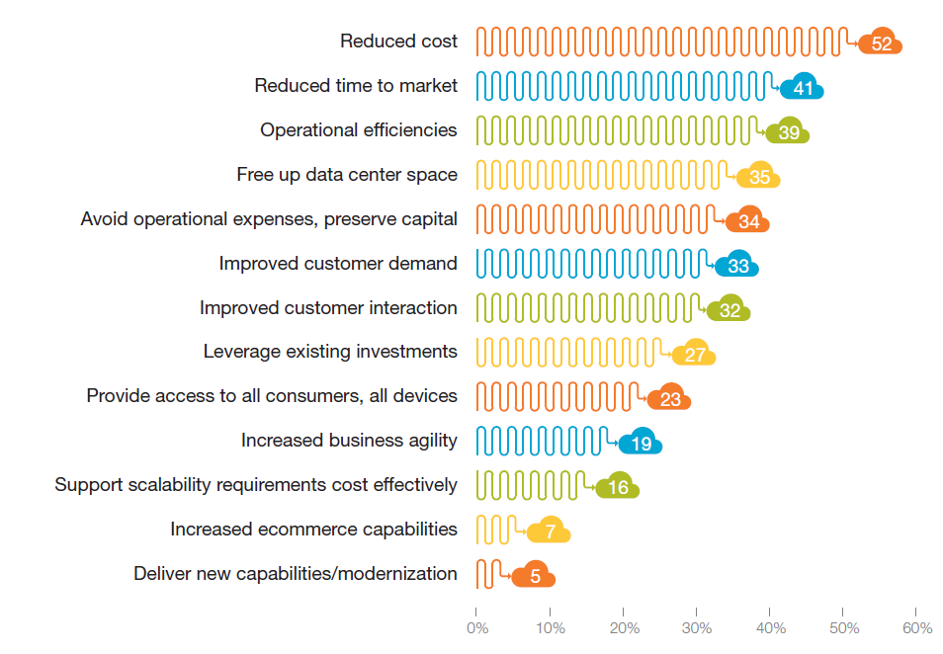
1.7:Cloud benefits and Challenges What are the business drivers behind moving to the cloud?

Slide 36
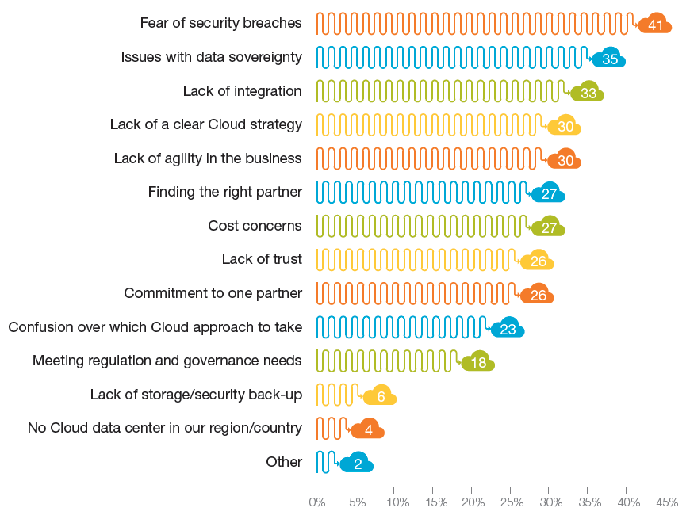
1.7: Cloud benefits and Challenges And what are the uncertainties?

Slide 37
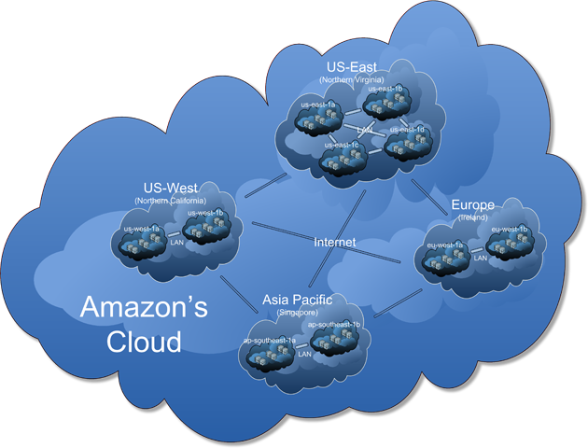
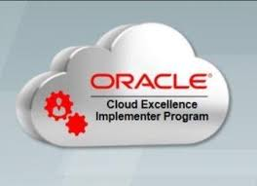
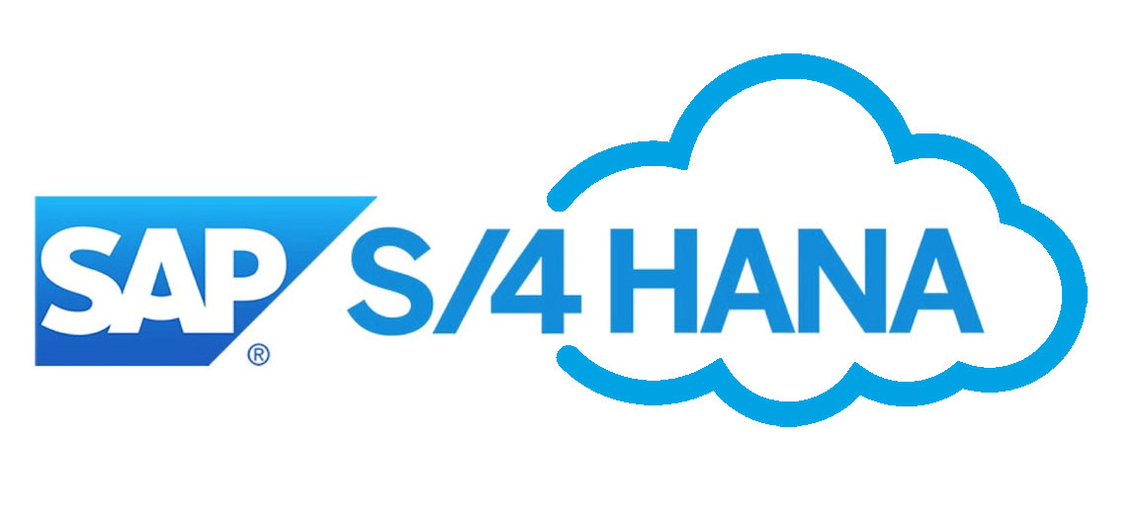
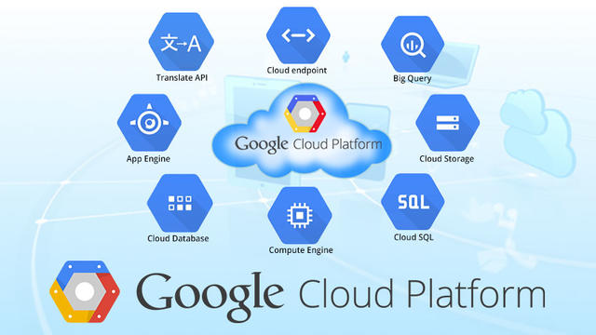
1.8: Cloud implementer Cloud implementer?

Slide 38
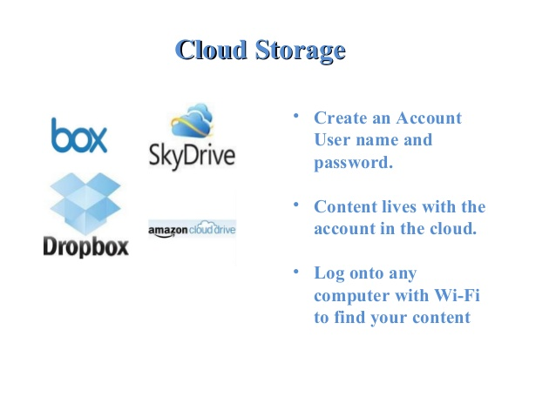
1.9: Cloud implementer Current trend
Cloud Storage
Download For Storage
Download a cloud based app to on your computer •
The app lives on your Computer
Save files to the app
When connected to the Internet it will sync with the cloud
The Cloud can be accessed from any Internet connection
Notes:
Cloud Storage :---
Create an Account User name and password. •
Content lives with the account in the cloud. •
Log onto any computer with Wi-Fi to find your content
Download For Storage :---
Download a cloud based app to on your computer •
The app lives on your Computer •
Save files to the app •
When connected to the Internet it will sync with the cloud •
The Cloud can be accessed from any Internet connection

Slide 39
Summary
In this lesson, you have learnt:
What is and Why Cloud?
Why Cloud Computing
Key characteristics of Cloud
Cloud Computing Architecture
Cloud Deployment Model and Service Model Selection criteria
Cloud APIs
Cloud benefits and Challenges
Different Cloud implementer
Latest trend

Slide 40
Review – Questions
Question 1: _____is a distributed computing on Internet or delivery of Computing service over the Internet.
Question 2: _____________ and ___________ are The Working models of Cloud computing
Notes:
Answers for the Review Questions:
Answer 1: Cloud computing
Answer 2: Deployment model and Service model

Slide 41
Review – Questions
Question 3: _________ allows systems and services to be easily accessible to the general public and may be less secure because of its openness.
Question 4: _________ allows systems and services to be to be accessible by group of organizations.
Question 5: Which of the following is not a service model in Cloud
Option 1 : IAAS
Option 2 : PAAS
Option 3 : SAAS
Option 4 : LAAS
Notes:
Answers for the Review Questions:
Answer 3: Public cloud
Answer 4: Community Cloud
Answer 5: LAAS

Slide 42
Review – Questions
Question 5: Which of the followings are Cloud Implementer
Oracle
Amazon
All of the above
Notes:
Answers for the Review Questions:
Answer 5: All of the above

